Slide 1


ING. DE SISTEMAS, FAC. INGENIERÍA

Slide 2

Curso de Microservicios con Spring Boot y Vue

Slide 3

MICROSERVICIO PRODUCT
.

Slide 4
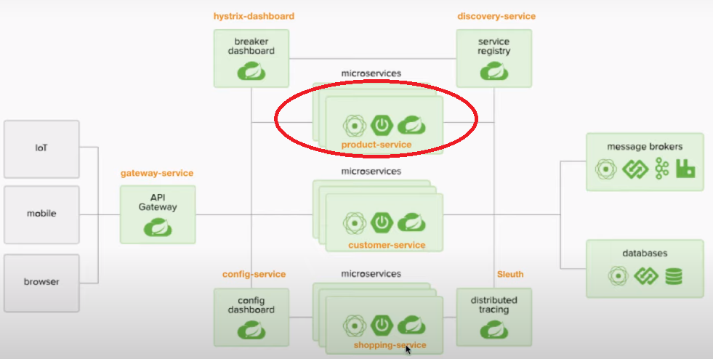

Slide 5
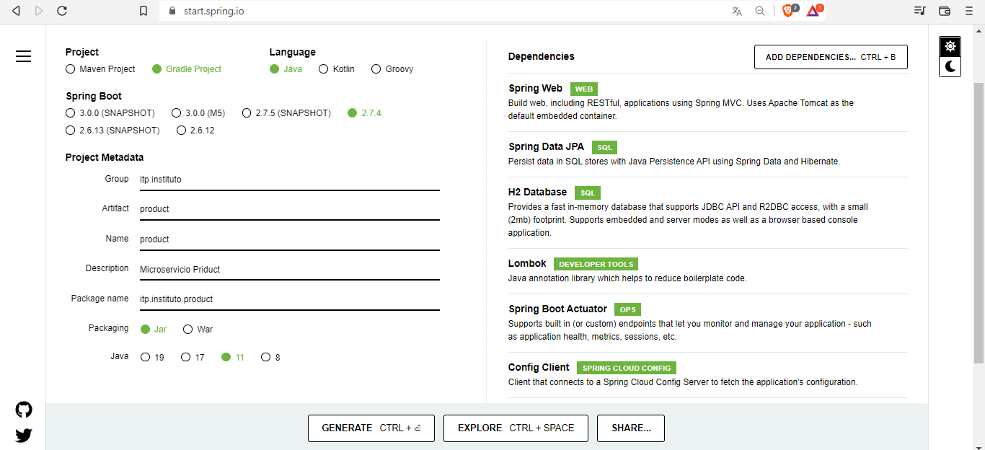
PRODUCT

Slide 6
DEPENDENCIAS
Spring Web Build web, including RESTful, applications using Spring MVC. Uses Apache Tomcat as the default embedded container.
Spring Data JPA Persist data in SQL stores with Java Persistence API using Spring Data and Hibernate.
H2 Database SProvides a fast in-memory database that supports JDBC API and R2DBC access, with a small (2mb) footprint. Supports embedded and server modes as well as a browser based console application.
Lombok Java annotation library which helps to reduce boilerplate code.
Spring Boot Actuator Supports built in (or custom) endpoints that let you monitor and manage your application - such as application health, metrics, sessions, etc.
Config Client SClient that connects to a Spring Cloud Config Server to fetch the application's configuration.
Eureka Discovery Client SA REST based service for locating services for the purpose of load balancing and failover of middle-tier servers.
Sleuth Distributed tracing via logs with Spring Cloud Sleuth.

Slide 7
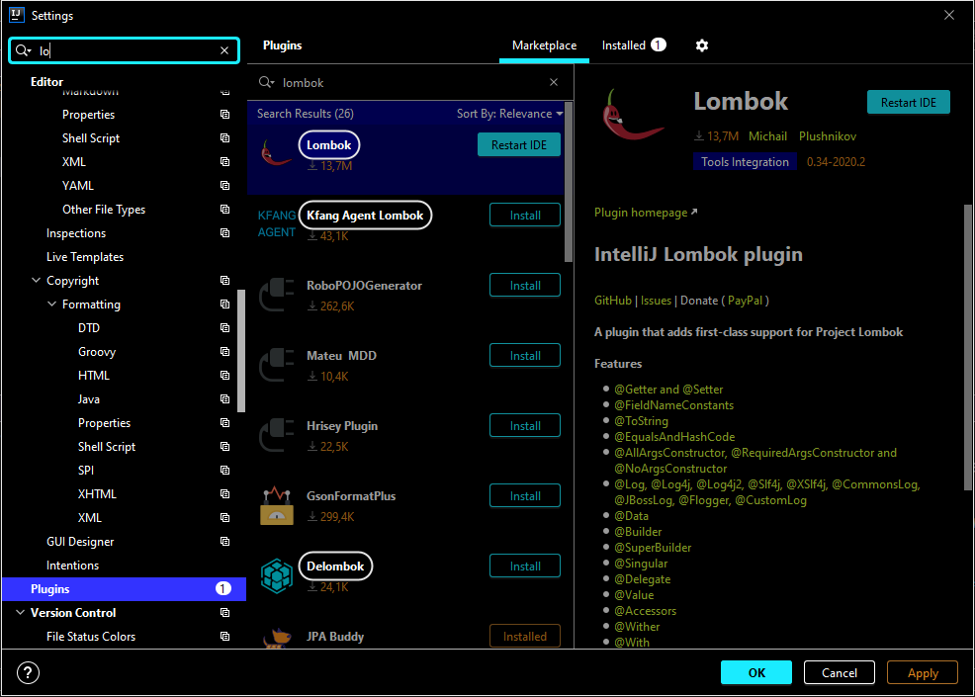
LOMBOK

Slide 8
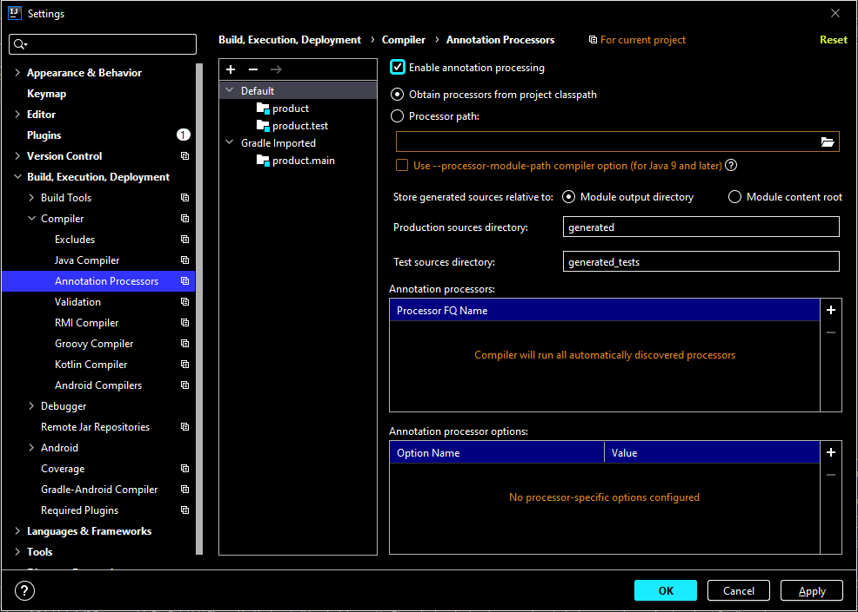

Slide 9
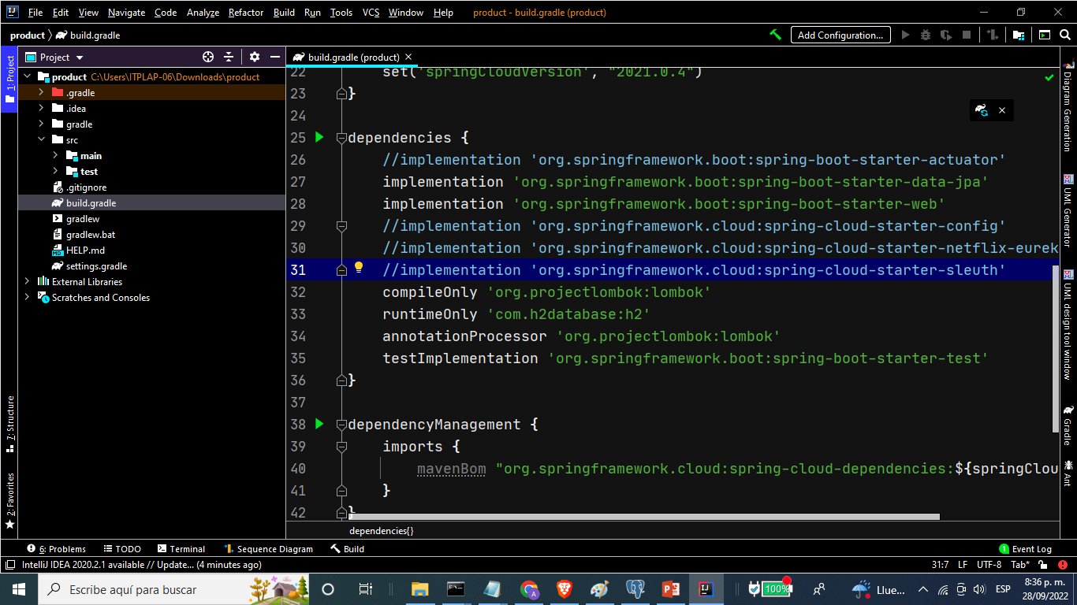

Slide 10
Crear Entidades
CategoriaProductos
Productos

Slide 11
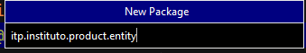
Crear Paquete entity

Slide 12
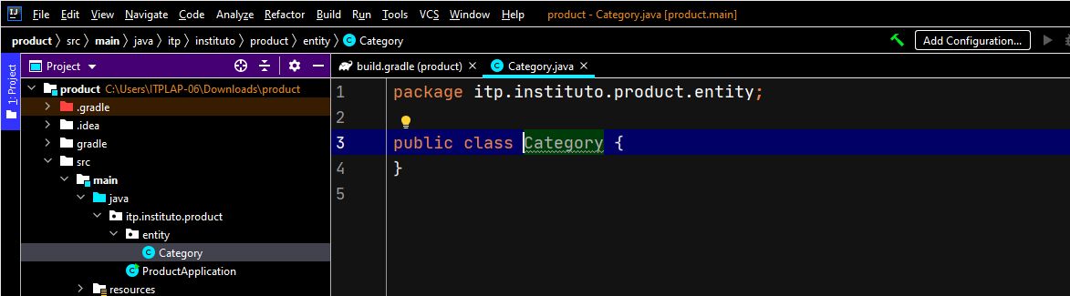
Crear clase Categoria

